Slide 1
The Reality of Physician Assisted Suicide in Oregon & What it Means presentation to
Medical Ethics Class
University of Oregon
February 27, 2013
Dr. Kenneth R. Stevens, Jr., M.D.

Slide 2
Dr. Kenneth R. Stevens, Jr., MD
Radiation Oncologist (cancer doctor) for 46 years
Former Department Chair and currently
Professor Emeritus, Radiation Oncology,
Oregon Health & Science University,
Portland, Oregon
President
Physicians for Compassionate Care Education Foundation
www.pccef.org

Slide 3
Francis W Peabody, MD
Harvard Medical School Teacher
“ the secret of the care of the patient
is in caring for the patient ”
“The Care of the Patient”
J American Medical Assoc 1927; 88:877-882

Slide 4
Definitions – use correct language
Physician-assisted suicide: Physician facilitates a patient’s death by providing the necessary means and/or information to enable the patient to perform the life-ending act. Provides sleeping pills and information about the lethal dose while aware the patient may commit suicide.
Euthanasia: Active causation of death of patient by physician by lethal injection.

Slide 5
American Medical Association Code of Ethics
Allowing physicians to participate in assisted suicide would cause more harm than good.
Physician-assisted suicide is fundamentally incompatible with the physician’s role as healer, would be difficult or impossible to control, and would pose serious societal risks.

Slide 6
I did not go into medicine to kill people !
Dr. Stevens quoted in
New York Times, Katie Hafner article
August 11, 2012

Slide 7
For 2400 years, physicians have withstood the allure of promoting death. We have cared for the weak and outcast when others have turned away.
Today’s pressures include economic ones; such forces may compromise patient care and promote assisted suicide.

Slide 8
Physicians have the duty to safeguard human life, especially life of the most vulnerable: the sick, elderly, disabled, poor, ethnic minorities, and those whom society may consider the most unproductive and burdensome.

Slide 9
Suicide Prevention
When a person expresses a desire to take their own life, society acts to protect that person from committing suicide.
However, when assisted suicide is legalized, society than acts to assist that person in committing suicide.
This is especially true for those who are seriously ill or have disabilities – they have lost society’s protection against suicide.

Slide 11
The focus of assisted suicide legalization is to give doctors legal protection and the right to kill patients.
The focus is not on comfort care.
The focus is not on pain management.
The focus is not on palliative care.
The focus is to legalize assisted suicide.

Slide 12
Legalization of assisted suicide does not give any new rights to patients.
It’s purpose is to legally protect doctors who write prescriptions for lethal drugs.
Legalization of assisted suicide takes away from terminally ill and disabled patients, the protection against doctors who order their death by a prescription for lethal drugs.

Slide 13
DOUBLESPEAK
In his 1993 book, “Lawful Exit”, Derek Humphry, founder of the Hemlock Society, devoted a chapter titled “DoubleSpeak” to the importance of language.
The proponents of assisted suicide use euphemisms in their campaign to legalize assisted suicide.
But suicide is still suicide

Slide 14
“You will never get accustomed to killing somebody.”
Writing a lethal prescription is like “giving a patient a loaded gun and just asking them not to shoot before you leave the house.”
Pieter Admiraal, M.D. leader of The Netherlands’ euthanasia movement
American Medical News 9/15/1997

Slide 15
Michael Freeland (Mr. A) received substandard medical care
Assisted suicide leads to dumbing-down of medicine
63-year old with lung cancer, received lethal drugs without a psychiatric evaluation, even though he had a history of suicide-attempts.
He was committed involuntarily to a hospital psychiatric unit because of suicidal & homicidal concerns. Guns removed.
Judge declared him to be incompetent; all while he had lethal drugs in his home.
At time of hospital discharge, a palliative care consultant wrote that he probably needed attendant-care at home, but that was a “moot point” because he had “life-ending medication”.
Substandard medical care because of assisted suicide.
http://ajp.psychiatryonline.org/cgi/reprint/162/6/1060

Slide 16
What does terminal mean?
Life-expectancy is difficult to predict
Dr. J. Englebert Dunphy, MD
(Prominent US surgeon):
“My personal experience made it obvious to me that one cannot predict the precise course or outcome of cancer.
“The adage ‘he will be dead in 6 months’ is an unforgiveable statement for a physician to make”.
“Annual Discourse - On Caring for the Patient with Cancer”, New England Journal Medicine, Aug 6 1976
Presented at annual meeting Massachusetts Medical Society

Slide 17
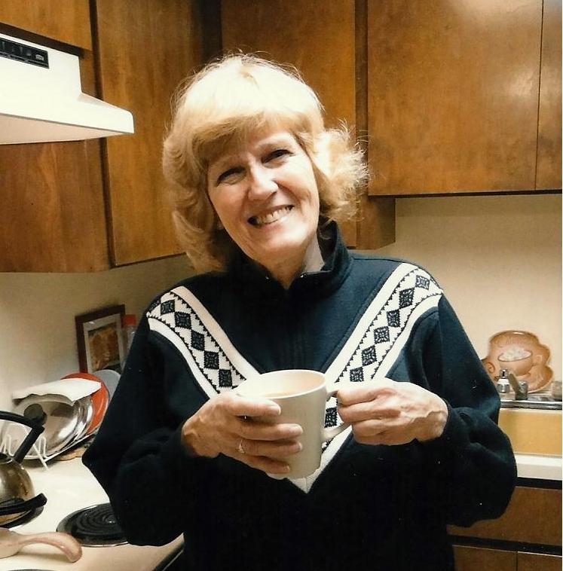
Jeanette Hall – cancer patient lured to assisted suicide
In 2000 was diagnosed with cancer, she refused treatment and wanted assisted suicide. She had voted for it.
Without treatment, she was told she had 6 to 12 months to live.
After 4 weekly visits with me, I helped her have hope, she completed treatment, the cancer disappeared.
“I’m Alive - 13 years later!”

Slide 18
Pain is Not the Issue
It is a smoke-screen
Pain can be controlled.
Uncontrolled pain in the terminally ill rarely occurs.
In Oregon only a very small minority of patients dying of Physician-assisted Suicide chose it because of fear of pain in the future. This was not because they were having pain.

Slide 19
If intolerable suffering were the reason for physician-assisted suicide, then why is it not successfully promoted in areas of the world where there really is such intolerable suffering?
Why is assisted suicide & euthanasia only successfully promoted in affluent societies?

Slide 20
The message that proponents of assisted suicide are giving to the public and to patients, is that doctors can do a better job of killing patients than they can of caring for their medical needs.
Patients worry that doctor becomes the attorney, judge, jury and executioner.

Slide 21
“No matter how carefully any guidelines are framed, assisted suicide and euthanasia will be practiced through the prism of social inequality & bias that characterize the delivery of services to all segments of society, including health care. Growing concerns about health care costs increase the risks presented by legalizing assisted suicide and euthanasia. This cost consciousness will no be diminished, and may be exacerbated, by health care reform.”
New York Task Force on Life and Law 1994
Assisted Suicide and Euthanasia

Slide 22
People with disabilities fear assisted suicide
Disability Rights advocates are appalled at the negative assisted suicide message directed to people with disabilities.
Assisted Suicide advocates de-value those who are disabled by playing on the “horror of dependency”. “There are conditions worse than death”.
Those with disabilities fear they will be the next targets of Assisted Suicide.
They have formed “Not Dead Yet” and “DREDF” organizations.

Slide 23
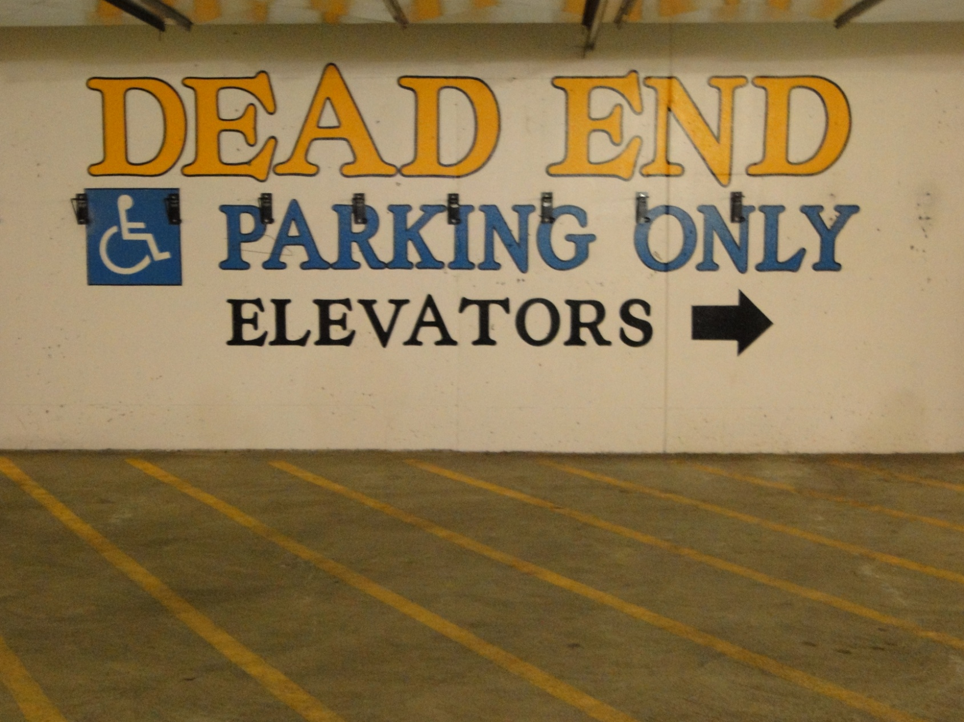
Is Disability a Dead End?

Slide 24
Depression
Depression is the leading cause of suicide.
Depression needs to be diagnosed and properly treated with counseling and medications.
Oregon researchers reported in 2008 that 25% of Oregonians requesting assisted suicide were depressed.
Yet, in the past 6 years only 1% (5 of 381) of Oregonians dying of assisted suicide had a psychiatric evaluation.

Slide 25
Assisted Suicide is Cheap – save $$$
There are financial reasons why HMOs or state medicaid programs may promote cheaper Assisted Suicide, rather than have prolonged cost of caring for a patient with chronic disease.
There is concern that vulnerable people with limited-resources may feel that Assisted Suicide is their only choice.

Slide 26
Physician-assisted Suicide and Euthanasia can help solve the problem of rising health care costs says Derek Humphry of
Hemlock Society 12/2/1998

Slide 27
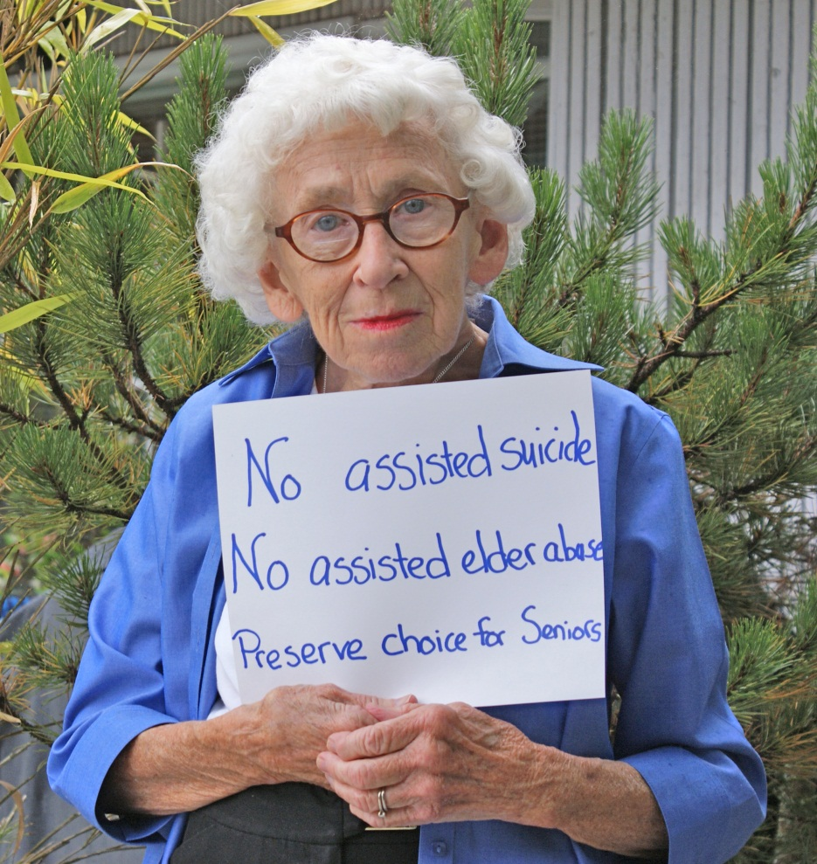
Choice is an Illusion
Assisted Suicide is a recipe for elder abuse.
In Oregon, legalization has empowered the Oregon Health Plan to steer citizens to suicide.
Other suicides have increased with the legalization of assisted suicide.
Legalization will decrease personal choice

Slide 28
Oregon is rationing cancer treatment, but offering assisted suicide to cancer patients
Oregon Health Plan (Medicaid) limits treatment with intent to prolong survival.
Barbara Wagner – The Oregon Health Plan (Medicaid) refused to cover beneficial life-extending cancer treatment, but offered assisted suicide instead.
http://www.katu.com/home/video/26119539.html

Slide 29

Barbara Wagner - Oregon Health Plan

Slide 30
Kate Cheney-age 85 died 8/29/1999
“Kate’s choices may be influenced by her family’s wishes and her daughter may be somewhat coercive.” – evaluating psychologist

Slide 31
Kate Cheney - Questions ?
She was turned down for assisted suicide because psychiatrist Dr. Linda Ganzini, Oregon’s most experienced assisted-suicide investigator, determined that Kate Cheney was not capable of making that decision.
Her daughter’s assertiveness about getting the lethal dose made the psychiatrist wonder whose agenda this really was. Whose choice? Assisted suicide is a recipe for abuse.
Doctor-shopping resulted in her getting the lethal dose and dying of assisted suicide.
“Is Mom capable of choosing to die?”
EH Barnett, The Oregonian newspaper, 10/17/1999.

Slide 32
Legalizing assisted suicide does not improve end-of-life care
“Last Acts” in a 11/18/02 report gave Oregon mixed ratings on end-of-life care.
In several aspects of palliative care, Oregon received lower grades than many states which ban assisted suicide.
Oregon researchers found that after the legalization of assisted-suicide that there were more Oregon patients dying of pain then there were previously.

Slide 33
What about Suicides?
2009 year information – rate per 100,000 population http://www.suicidology.org
Oregon’s rate of suicide – 16.8 [ 644 #]
National rate of suicide - 12.0 [ 36,909 #]
Oregon’s rate of suicide is 140% of national rate. Adding 59 assisted suicide deaths to 644, totals 703 suicides; results in an Oregon rate that is 153% of the national average.

Slide 34
Oregon has a real problem with its high suicide rate [8th highest in US]
Oregon’s suicide rate has been increasing since 2000. Assisted suicide start in 1998.
How do you justify suicide prevention in a state that has legalized assisted suicide?
What message does legalization of assisted suicide send to those who are considering suicide because of life’s problems?

Slide 35
There is a mistaken opinion that all Oregon assisted suicide patients have self-administered the lethal drugs.
The Washington Post (11/3/99) told how Dr. Rasmussen opened 90 capsules and poured the powder into chocolate pudding. He gave the mixture to the woman’s son who spooned the mixture into his mother’s mouth. Another son gave her sips of water to wash the solution down. All she did was swallow.
Is this self-administration?

Slide 36
Patrick Matheny 43–yr old.
His brother-in-law had to “help” him with assisted suicide because he could not have done it by himself.

Slide 37
What about Oregon’s Department of Health oversight of assisted suicide? It is a joke.
When Oregonians voted to legalize assisted suicide, the ballot measure stated there would be no cost to state government. You get what you pay for
Following a failed assisted suicide attempt in 2005, the Department of Human Services (DHS) stated that they had “no authority to investigate individual Death with Dignity cases – the law neither requires nor authorizes investigations from DHS”Press Release from DHS 3/4/2005
There is no real monitoring of Oregon’s assisted suicide experiment.
The 2011 Year report listed underlying illness as “Unknown” for 3 patients dying of assisted suicide. How can an “unknown” illness be terminal? Residence unknown for 3.

Slide 38
Doctor not present when drugs are taken by patient
In the past four years (2009-2012) the prescribing doctor has been present for only 22 of the 272 assisted suicide deaths in Oregon. Yet doctors are asked to describe what happened at that time. They have no knowledge.
How do we know what others are doing to influence and direct the suicide?
Doctors are not required to care for the patient once the prescription for lethal overdose has been written.
“The emperor has no clothes”

Slide 39
“A coterie of insiders runs the program with a handful of doctors & others deciding what the public may know.”
The Oregonian newspaper editorial- 9/20/2008
The Oregon assisted suicide organization (C&C) claims to have directed and controlled 75% of the assisted suicide deaths in Oregon. In 2009, 57 of the 59 assisted suicide deaths were their clients. They know and control the information released to the public.
There is a mask of silence regarding the details of assisted suicide in Oregon.

Slide 40
Death-Doctors
Oregon doctors specializing in assisted suicide
From 2001 to 2007, 109 doctors (1% of Oregon doctors) wrote 271 fatal prescriptions for assisted suicide.
From 2001 to 2007, 3 doctors wrote 62 of the 271 fatal prescriptions. That is 23% of the prescriptions written by only 3 doctors.
17 doctors wrote 165 of the 271 prescriptions, that is 61% of prescriptions.
Hedberg, J Clin Ethics 2009; 20:124-132

Slide 41
Oregon’s assisted suicide proponent organization C&C
State they are the authors of the assisted suicide law, describe themselves as the guardian of that law, advocate and campaign for legalization of assisted suicide in other states.
They are associated with three-fourths of Oregon’s assisted suicide deaths, and with 57 of the 59 deaths in 2009.

Slide 42
Numbers & Proportion of Oregon Assisted Suicide Deaths who were clients of Compassion & Choices (C&C) Organization

Slide 43
Compassion & Choices
C&C
Conspiracy & Control
Compassion & Choices is like the fox in the proverbial chicken coop; in this case the fox is reporting its story to the farmer regarding what is happening in the coop.
C&C’s non-physician executive director (an attorney) reported in 2007 that he had attended more than 36 assisted suicide deaths, even helping to prepare the drugs.

Slide 44
The assisted Suicide movement speak of the “safeguards” in Oregon’s Assisted Suicide Act. However, these “safeguards” are really boundaries or “fences”.
They are a barrier for access to assisted suicide for those outside these boundaries.

Slide 45
This is a very fatal flaw in the assisted suicide argument.
Autonomy & Boundaries don’t mix.
Unbounded autonomy has no boundaries.
The boundaries around assisted suicide are elastic.
They have stretched like a rubber band, and will continue to stretch.
The nature of unbounded autonomy ultimately leads to loss of autonomy.

Slide 46
It is illegal for Oregonians to pump their own gas.

Slide 47
What is ahead for assisted suicide – what do the proponents want?
This is the slippery slope
They want no “safe harbor for patients”. Doctors should be required to participate or refer patient to a doctor who will write a lethal prescription. No choice for doctors.
Eliminate reporting requirements.
Extend to non-terminal and demented patients, who are not capable of choosing.
Allow euthanasia, lethal injection

Slide 48
Physicians who care for patients should not order and direct their death.
It is against medical ethics: “Give no deadly drug”.
It is too dangerous to give the power to kill patients to the medical profession.
It is dangerous because of insurance company and government financial incentives.
It destroys the inherent trust between patient and physician.
It devalues the inherent value of human life.
It desensitizes us towards any type of suicide.

Slide 49
When a doctor writes a prescription for assisted suicide, the message is:
Your life is not worth living.
You are better off dead.
I don’t value you or your life.
I want you dead.
I order you to die.
I direct you to die.
It destroys trust between patient and physician.

Slide 50
My personal story:
In 1982, my wife with advanced cancer, and I went to her doctor again.
She was told “Nothing more can be done.”
Doctor: “I can write an ‘extra-large’ prescription for pain medication for you.”
My wife: “He wants me to kill myself.”
She was devastated that her physician, her trusted physician, would subtly suggest that her life was no longer of value.
Assisted suicide decreases trust between patient and doctor.

Slide 51
Revised Good Samaritan Parable
WHO IS MY NEIGHBOR? Luke 10:29-37
A certain man going down from Jerusalem fell among thieves which stripped him of his raiment and wounded him, leaving him half dead. A priest saw him and passed by on the other side. A Levite came and looked on him and passed by on the other side.
But a certain Samaritan came where he was, when he saw him he had compassion on him, and he gave him fatal poison, and put the half-dead man out of his misery; permitting better use of his money.
Which of these three was neighbor unto him that fell among thieves? He that showed mercy on him.

Slide 52
Which Good Samaritan Doctor does Society want to care for them?
Choose Well

Slide 53
Recommended Publications
The Case Against Assisted Suicide, Foley & Hendin,
Johns Hopkins Press, 2002
Forced Exit, The slippery slope from Assisted Suicide to Legalized Murder, Wesley Smith, Spence Publishing, 2003, www,spencepublishing.com
Culture of Death, Wesley Smith, Encounter Books, 2000
Power Over Pain, How to get the pain control you need, Chevlen and Smith, International Task Force (paperback), 2002, $13.
Emotional & Psychological Effects of Physician-Assisted Suicide & Euthanasia on Participating Physicians, KR Stevens, Issues in Law & Medicine 21:187-200, 2006. (http://www.pccef.org/art44.htm)
Physician-Assisted Suicide in Oregon: A Medical Perspective, Hendin & Foley, Michigan Law Review, 106:1613-1640, 2008 http://www.michiganlawreview.org/assets/pdfs/106/8/hendinfoley.pdf

Slide 54
Recommended Websites
www.pccef.org Physicians for Compassionate Care
www.choiceillusion.org Choice is an Illusion
www.patientsrightscouncil.org Patients Rights Council
www.hospicepatients.org Hospice Patients Alliance
www.epcc.ca Euthanasia Prevention Coalition
www.notdeadyet.org Not Dead Yet
http://dredf.org/assisted_suicide Disability Rights Education & Defense Fund

